Slide 1




SPOTIFY MUSIC DATASET ANALYSIS & PREDICTION
Presented By :
ABHIPSA ROUT
Guided By :
Ms. GITANJALI DIGAL

Slide 2




Content
Introduction
Description
Technologies Used
Data Exploration
Prediction from the Dataset
Approach
Dashboard
Conclusion

Slide 3



Introduction
Spotify is one of the most popular and widely used music streaming platforms in the world, offering access to millions of tracks from artists across various genres and regions. It provides users with personalized playlists, recommendations, and the ability to explore global music trends.

Slide 4


Description
Dataset includes attributes such as year, artist, acousticness, danceability, energy, etc.
Exploratory Data Analysis (EDA) performed to identify patterns.
Regression models applied for predicting popularity.

Slide 5
Technologies Used
Python – The primary programming language for data analysis, visualization, and machine learning.
Pandas & NumPy – For efficient data manipulation, cleaning, and numerical computations.
Matplotlib & Seaborn – For creating detailed and visually appealing data visualizations to understand patterns and trends.
Scikit-learn – For building, training, and evaluating machine learning models for song popularity prediction.
Jupyter Notebook – An interactive development environment for writing code, visualizing data, and documenting the workflow.

Slide 6
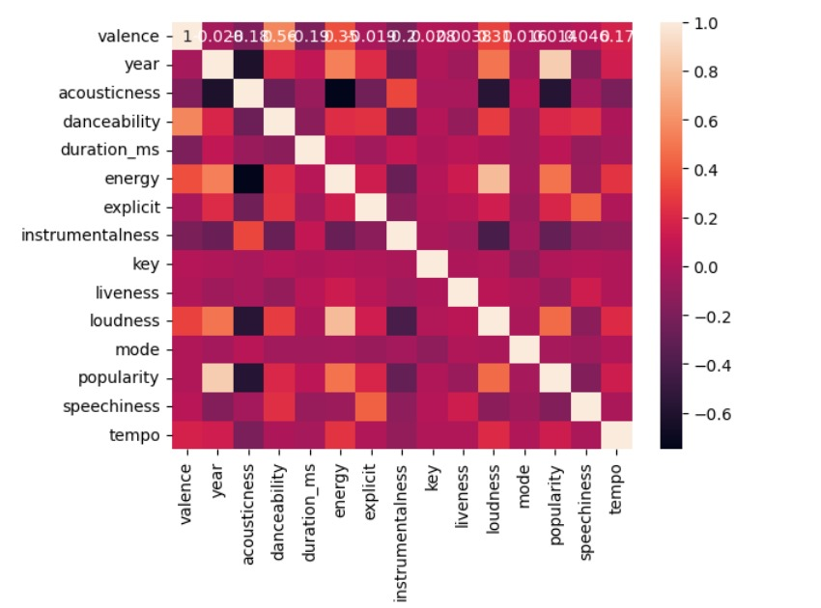
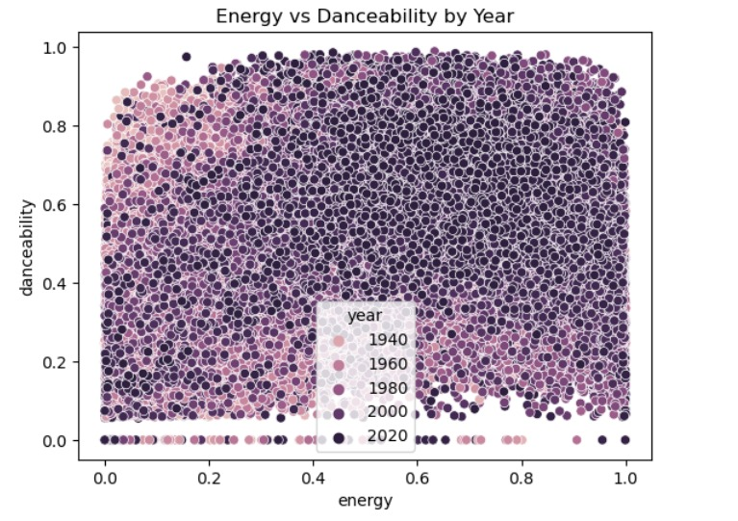
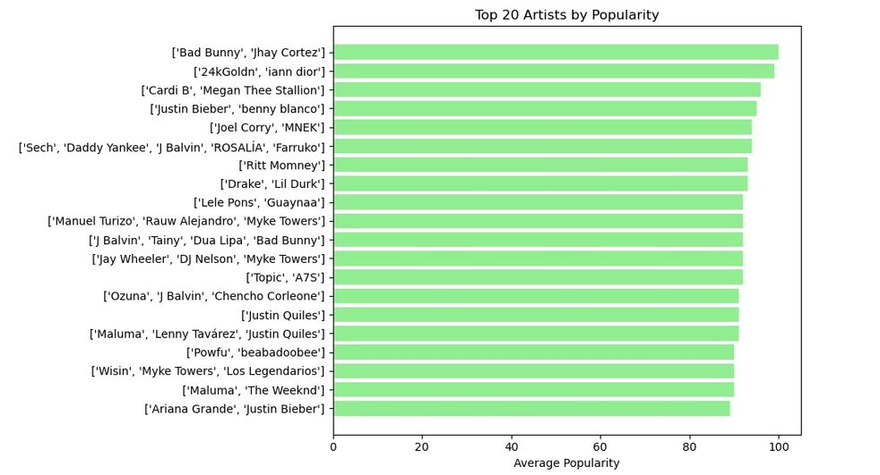
Correlation Heatmap of Numeric Features
Energy vs Danceability by Yesr
Top 20 Artists by Average Popularity

Slide 7
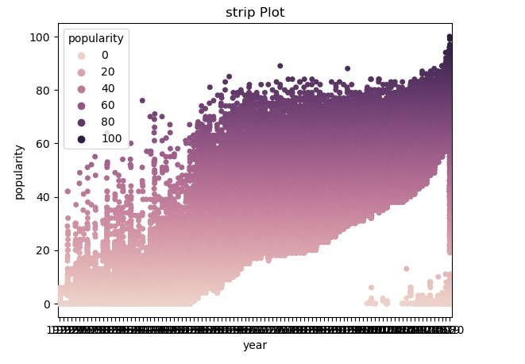
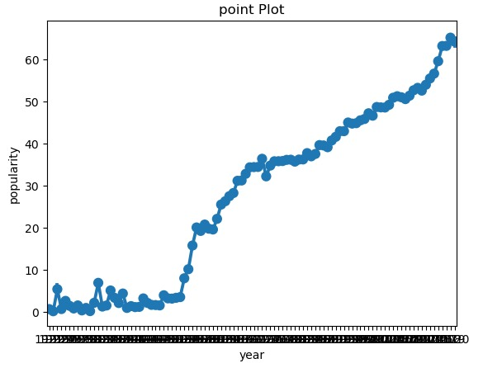
Strip plot of track popularity by release year, color from light (low) to dark (high).
Popularity Spread by Year

Slide 8
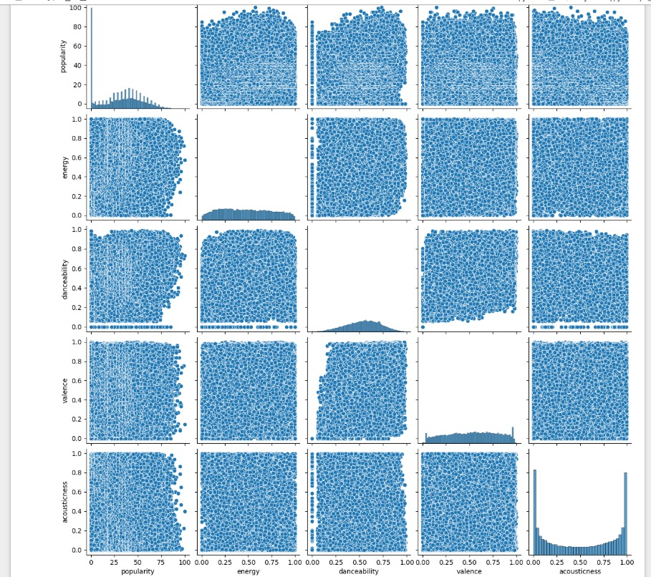
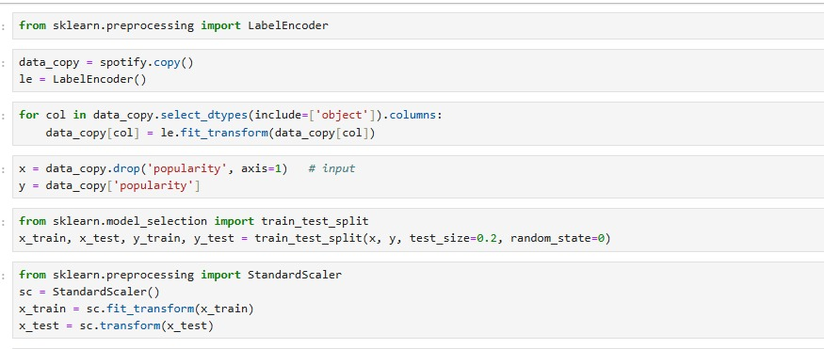
Pair Plot
Pair plot showing relationships between popularity, energy, danceability, valence, and acousticness.
Encoding and Train -Test Split

Slide 9
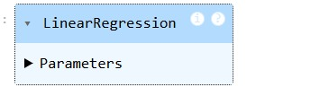
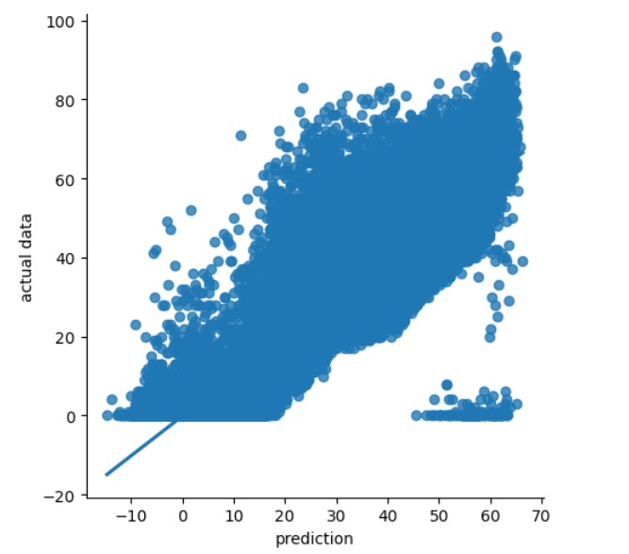
Linear Regression Model
Model Performance

Slide 10

Data Exploration
Statistical summary of dataset.
Distribution analysis of key features.
Correlation analysis between song features and popularity.

Slide 11

Prediction from the Dataset
Regression models applied: Linear Regression, Random Forest Regressor.
Evaluation metrics: MAE, MSE, R².
Identified important features affecting popularity.

Slide 12
Approach
FOLLOWED THE SPOTIFY SONGS ANALYSIS BY DIFFERENT PARAMETERS:
MAKING A DASHBOARD:

Slide 13
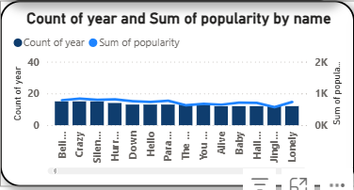
1. Count of Year & Popularity by Song Name (Combo Chart)
Popularity shows a steady upward trend over time, crossing 120K+.
Forecast suggests continuous growth, indicating future engagement rise.

Slide 14
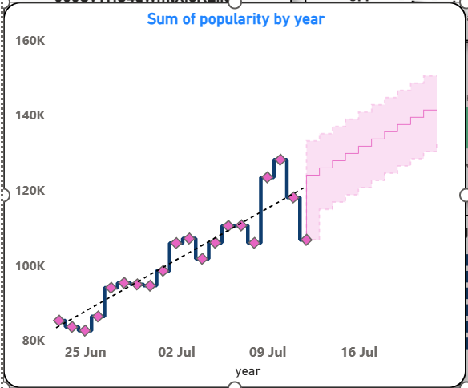
2. Sum of Popularity by Year (Time Series with Forecast)
Popularity shows a steady upward trend over time, crossing 120K+.
Forecast suggests continuous growth, indicating future engagement rise.
rise.

Slide 15
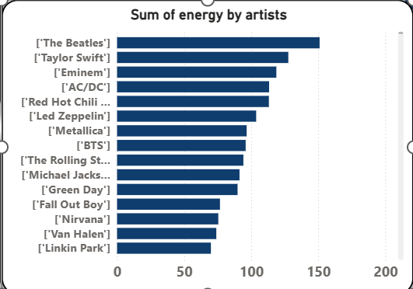
3. Sum of Energy by Artists
(Bar Chart)
Sum of Energy by Artists (Bar Chart)
Top contributors in energy are The Beatles, Taylor Swift, Eminem, AC/DC.
Rock & Pop artists dominate energy-driven tracks.

Slide 16
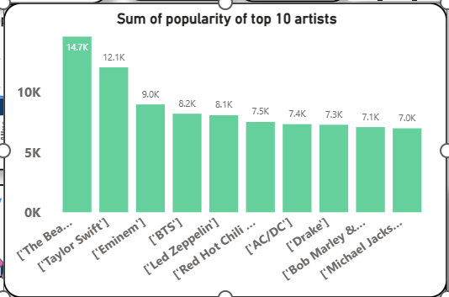
4. Sum of Popularity of Top 10 Artists (Bar Chart)
Sum of Popularity of Top 10 Artists (Bar Chart)
The Beatles lead in popularity with 14.7K, followed by Taylor Swift (12.1K).
Mix of classic and modern artists dominate the popularity rankings

Slide 17
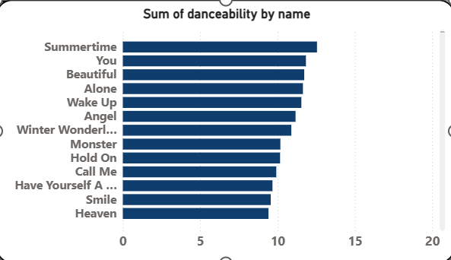
5. Sum of Danceability by Song Names (Bar Chart)
“Summertime,” “You,” and “Beautiful” are the most danceable songs.
Danceability values are spread across various song titles, showing versatility.

Slide 18
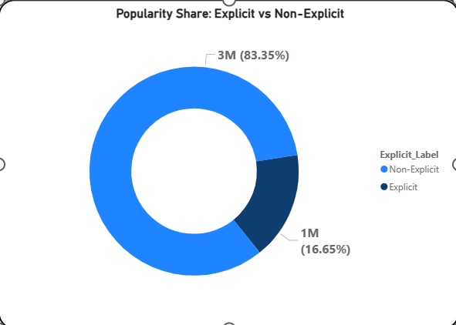
6. Popularity Share: Explicit vs Non-Explicit (Donut Chart)
Majority of songs are Non-Explicit (83.35%) compared to Explicit (16.65%).
Indicates Spotify library leans heavily toward family-friendly/non-explicit tracks.

Slide 19
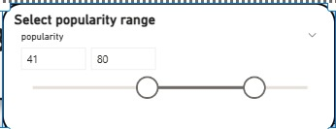
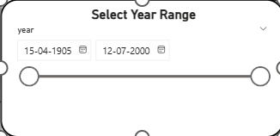
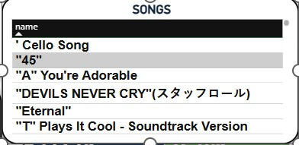
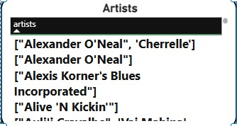
Popularity Range Slider
Year Range Slidert
Songs list
Artists list

Slide 20
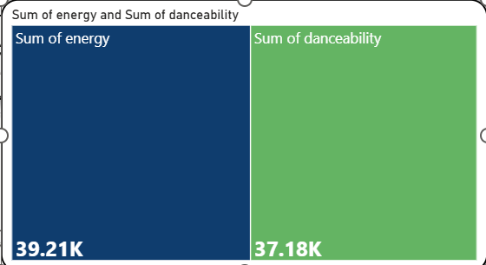
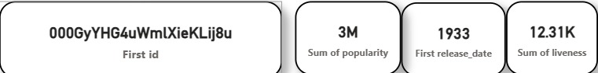
Sum of Energy & Danceability (Treemap)
Shows the overall distribution of total energy (39.21K) vs. danceability (37.18K) in songs.
Energy slightly dominates over danceability, highlighting energetic tracks' prevalence.
Dataset summary cards
Shows key dataset summary statistics: first ID, total popularity (3M), earliest release year (1933), and total liveness (12.31K).
Provides a quick, high-level overview of the dataset’s scope and scale for the presentation

Slide 21
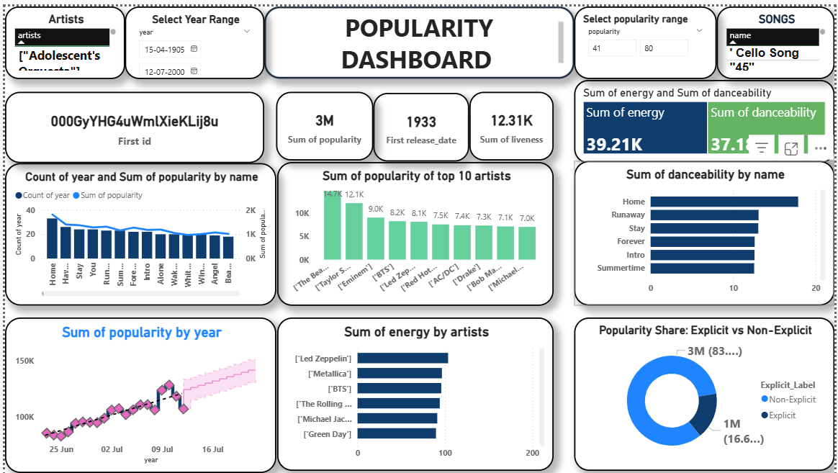
Dashboard

Slide 22
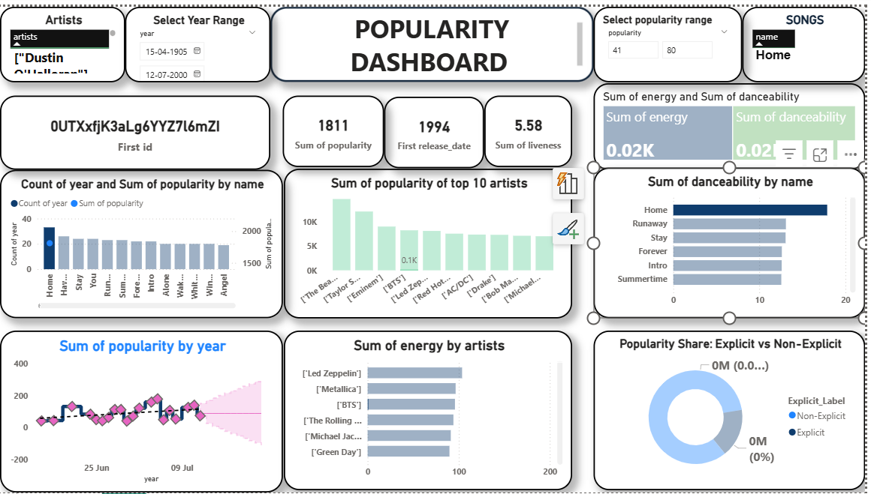

Slide 23
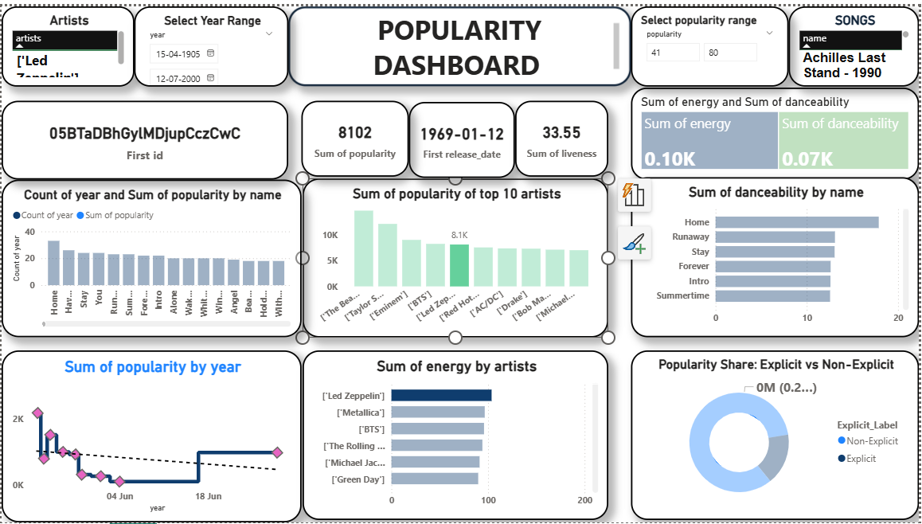

Slide 24
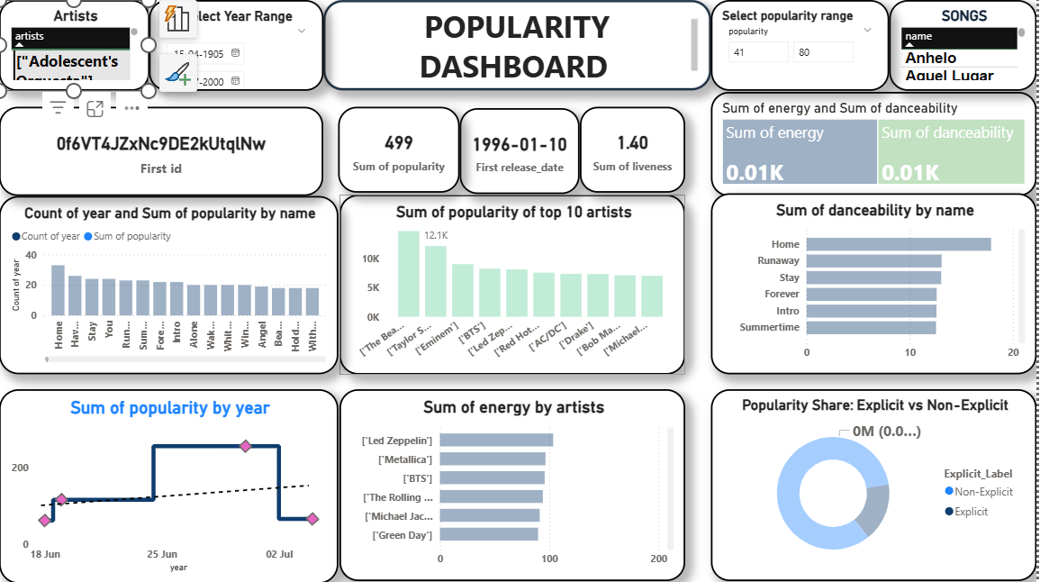

Slide 25

Conclusion
The dashboard provides an interactive view of Spotify data, allowing users to analyze songs by ID, name, popularity, release year, and audio features like liveness.
With slicers (e.g., popularity and year range), users can filter and explore trends over time, identify high-performing tracks, and gain insights for music recommendations, marketing strategies, and audience engagement.

Slide 26





Thank You!

